Slide 1
Uber Eats
João Gonçalves - up201806162
Pedro Coelho – up201806802

Slide 2
Problem Description
This project tackles the problem of the alocation of deliverers to orders in a food ordering system. Clients may have preference in what they prioritize, beeing it either the delivery cost or the delivery time. This being said the client engages in negotiation with the available drivers until a driver is allocated.
Independent variables: Deliverer speed, deliverer cost per distance unit, deliverer fuel.
Dependent variables: Delivery time, delivery cost.

Slide 3
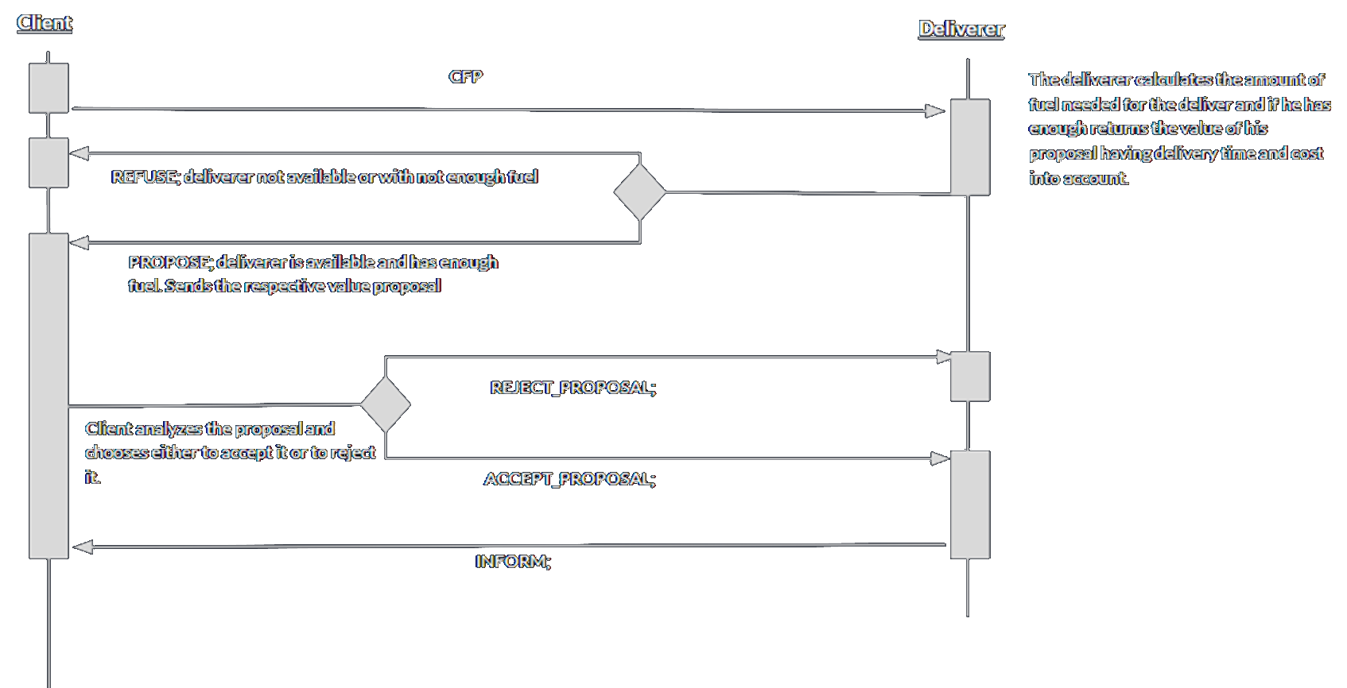
Protocols and interaction

Slide 4
Agents
There are 2 types of agents in the system.
Client Agents:
Creates a request for a pickup order at a restaurant of their choosing.
Accept or reject a proposal from a delivery agent
Deliver Agents:
Receive Requests and calculate offer cost
Perform the delivery at the cost of fuel and time.

Slide 5
Strategies
We decided to implement 3 types of client strategies evaluating the proposals in a different manner considering their preferences.
The 3 client types are:
Cost focused: attributes all proposal value to the cost of the delivery, disregarding delivery time.
Time focused: attributes all proposal value to the time that it takes to conclude the delivery, disregarding delivery cost.
Balanced: Attributes similar value to both parameters.

Slide 6
Experiments
During the development of the project several experiments were made with different number of clients and deliver agents, as well as their parameters.
Client and delivery agent parameters were also changed.
Client Agent parameters changed:
Position
Strategy
Deliverer Agent parameters changed:
Position
Travel speed
Cost per unit travelled
Fuel

Slide 7
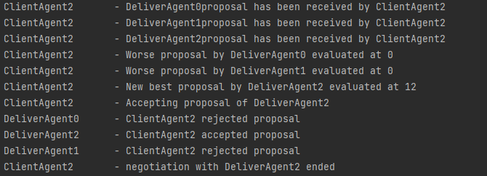
Experiments

Slide 8
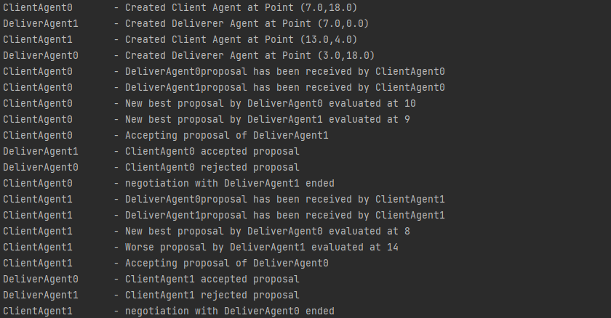
Experiments

Slide 9
Result Analysis
When the fuel carried by delivers is low only some of the orders are not fulfilled as the driver can’t cover the distance needed.
In general deliverers closer to the client/restaurant have the upper hand in fulfilling the delivers as all client strategies depend on distance from deliverer to the restaurant + distance from the restaurant to the client. By tuning the parameters we can have different results though, as for example if the closer driver is extremely slow and the client has the time focused strategy a driver further away can be a better option.
The same applies to cost. If a closer driver as an extremely high cost per unit travelled and the client is implementing the cost focused strategy the further away deliverer can have the best proposal

Slide 10
Conclusion
Overall this project was completed successfully. By using the Jade framework and the java programming language we were able to simulate a system of food delivery with multiple agents involved.
For future work we could implement the share ride feature to allow for a more dynamic allocation of resources, as well as implementing a visual interface to better visualize the systems execution.

Slide 11
Adicional Slides

Slide 12
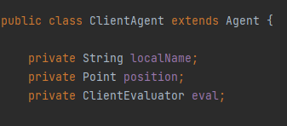
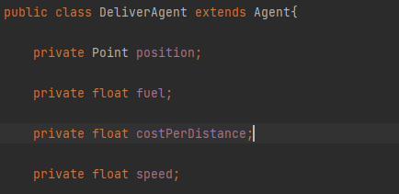
Implemented Important Classes
Agent Classes

Slide 13
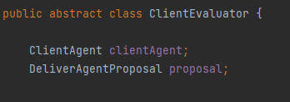
Abstract class ClientEvaluator is implemented by the 3 different evaluators that implemente each strategy.

Slide 14
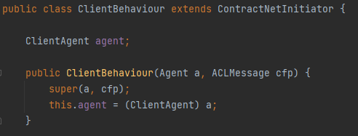
Extends the ContractNetInitiator class, acting as the Initiator in the FIPA Contract Net protocol

Slide 15
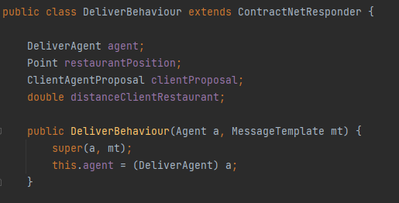
Extends the ContractNetResponder class, acting as the Responder in the FIPA Contract Net protocol,

Slide 16
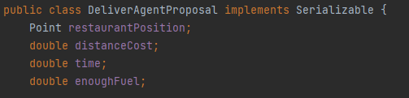
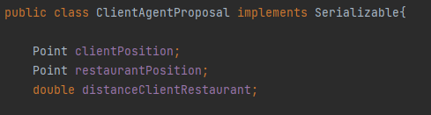
Encapsulates all the information needed to send the respective proposals

Slide 17
Execution example

Slide 18
